Slide 1
RESILIENT CYBER-PHYSICAL SYSTEMS THROUGH MACHINE LEARNING TECHNIQUES
Lopamudra Praharaj

Slide 2
Presentation Outline
Introduction to cyber physical system
Cyber physical Dataset and pre-processing
ML based Network anomaly detection
Transformer based Network anomaly detection
Adversarial attack on Machine learning based Network anomaly detector

Slide 3
Goals
Understanding
Awareness
Exploration
Adopt and Expand

Slide 4









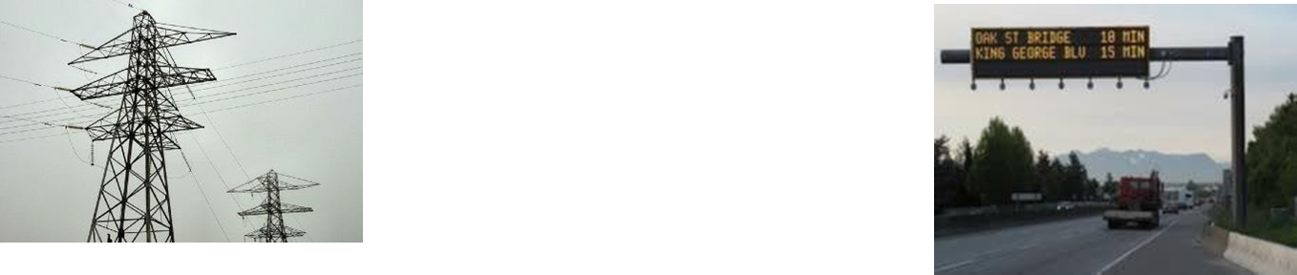
Modernization of our Physical Infrastructures
Industrial Control Systems
Manufacturing Automation Building Automation
Smart Grid
Intelligent Transportation ^{Systems}
Operations
Center

Slide 5

Smart Homes, Autonomous Vehicles, Agriculture

Slide 6
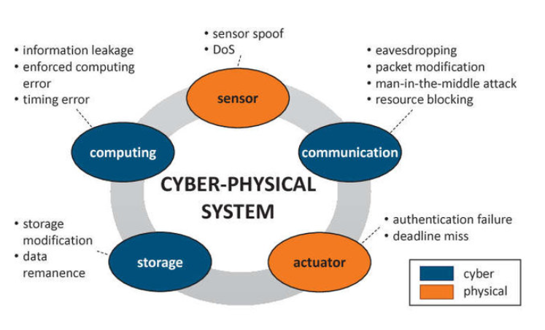
Cyber-Physical Systems

Slide 7

Cyber-Physical Systems
CPS are physical and engineered systems whose operations are integrated, monitored, and controlled by a computational core.
The computational core is embedded, typically demands response in bounded ‘real’ (physical) time, and is likely to be distributed and reconfigurable on-line.

Slide 8
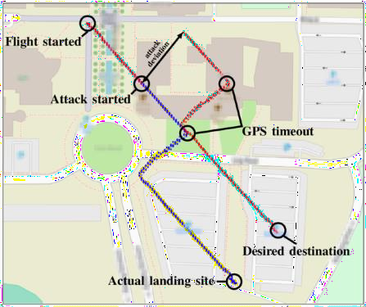

Cyber-Physical Systems Security

Slide 9


A decade ago it was hard to convince researchers this was a problem
Only one verified attack to control systems: 2000 attack on waste water control system

Slide 10




Why is CPS Security Different?
Security of Control Systems?
Nothing new!
Use normal IT security tools!
Not my job!
It’s the IT security guy’s job!
Control
Security
If attacker has partial control of system, it
can drive it to unsafe states.
Nothing new!
Safety and fault tolerance will save
the day!
Not my job!
It’s the control engineers job!
Attacks != Failures
12

Slide 11
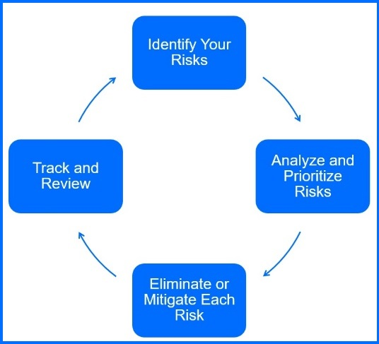
Security in CPS
Security is not only about keeping attackers
out
It is also about
Understanding risks
Mitigating
Detecting
Responding

Slide 12
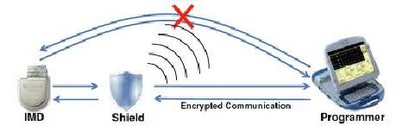
Preventing Attacks
^{Securing Legacy Systems}
Bump-in-the-wire
Wireless shields
Retrofitting security in legacy communications
Lightweight security
High-assurance systems
Preventing transduction attacks

Slide 13












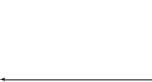












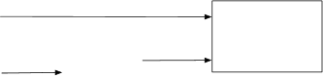



Detecting Attacks
Remote attestation
Misuse detection
Anomaly detection
Physics-based
attack detection
Active detection
v_{k}
Physical Process (Plant)
z_{k}
Actuators
Sensors
_{uk} (Under Normal Operation)
y_{k}
u
Reconfi
guration
k
Controller
r _{k}
Detection
Detection
Residual Generation
y_{k}
y_{k} −₁
u_{k}
r _{k}
Anomaly Detection: Sateless or Stateful
alert
Physical Model LDS or AR
y_{ˆk}
^{r} _{k} ^{= y} _{k}^{− y} ˆ
k

Slide 14
ML based Network anomaly detection

Slide 15
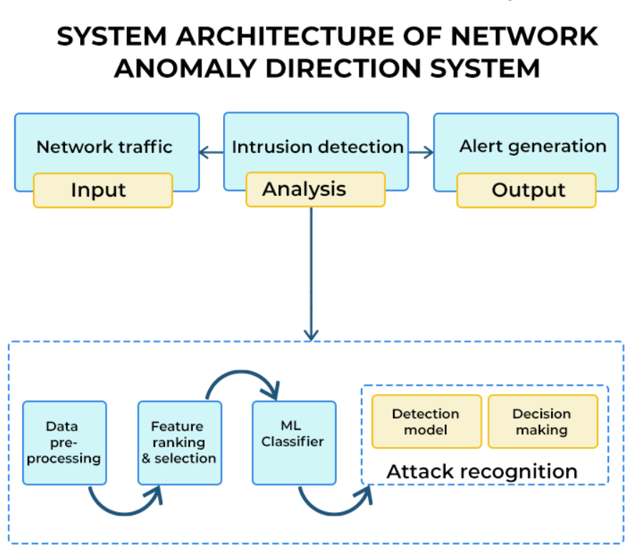

Slide 16
Anomaly Detection Strategies
Supervised Anomaly Detection
Labels available for both normal data and anomalies
Similar to rare class mining
Semi-supervised Anomaly Detection
Labels available only for normal data
Unsupervised Anomaly Detection
No labels assumed
Based on the assumption that anomalies are very rare compared to normal data

Slide 17
Classification
Anomaly Detection
Point Anomaly Detection
Nearest Neighbour Based
Density Based Distance Based
Contextual Anomaly Detection
Clustering Based
Collective Anomaly Detection
Statistical Parametric Non-parametric
Online Anomaly Detection
Others
Information Theory Based Spectral Decomposition Based Visualization Based
Distributed Anomaly Detection

Slide 18
Classification Based Techniques
Build a classification model for normal (and anomalous (rare)) events based on labelled training data, and use it to classify each new unseen event
Classification models must be able to handle skewed (imbalanced) class distributions
Categories:
Supervised classification techniques
Require knowledge of both normal and anomaly class
Build classifier to distinguish between normal and known anomalies
Semi-supervised classification techniques
Require knowledge of normal class only!
Use modified classification model to learn the normal behavior and then detect any deviations from normal behavior as anomalous

Slide 19
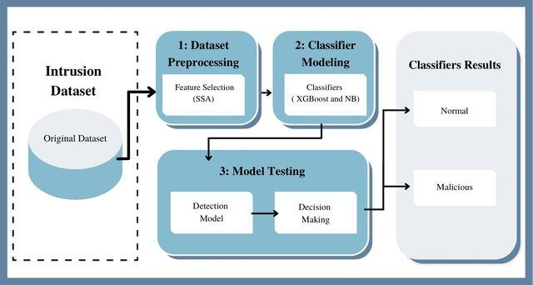
Classification Based Techniques

Slide 20
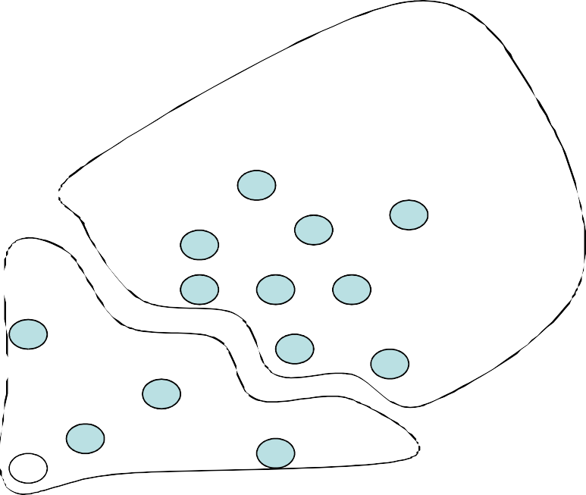
Using Support Vector Machines
Converting into one class classification problem
Separate the entire set of training data from the origin, i.e. to find a small region where most of the data lies and label data points in this region as one class
Separate regions containing data from the regions containing no data.
origin
push the hyper plane away from origin as much as possible
M. Amer, M. Goldstein, “Enhancing One-class Support Vector Machines for Unsupervised Anomaly Detection”, ODD’13, August 11th, 2013, Chicago, IL, USA.
23

Slide 21
Using Neural Networks
The ides here is to train neural network to predict a user’s next action or command, given the window of n previous actions.
Advantages:
They cope with noisy data
Their success does not depend on any statistical assumption about the nature of the underlying data
They are easier to modify for new user communities
Problems:
A small window will result in false positives, a large window will result in irrelevant data as well as increase the chance of false negatives.
The net topology is only determined after considerable trail and error.
The intruder can train the net during its learning phase.
Multi-layer Perceptrons
Auto-associative neural networks
Replicator NNs
21

Slide 22
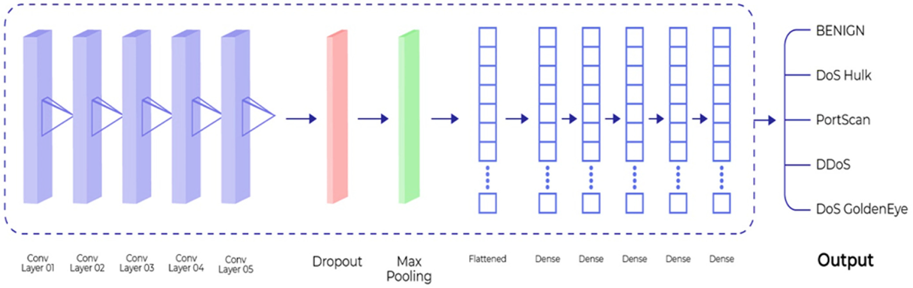
Using Neural Networks
21

Slide 23
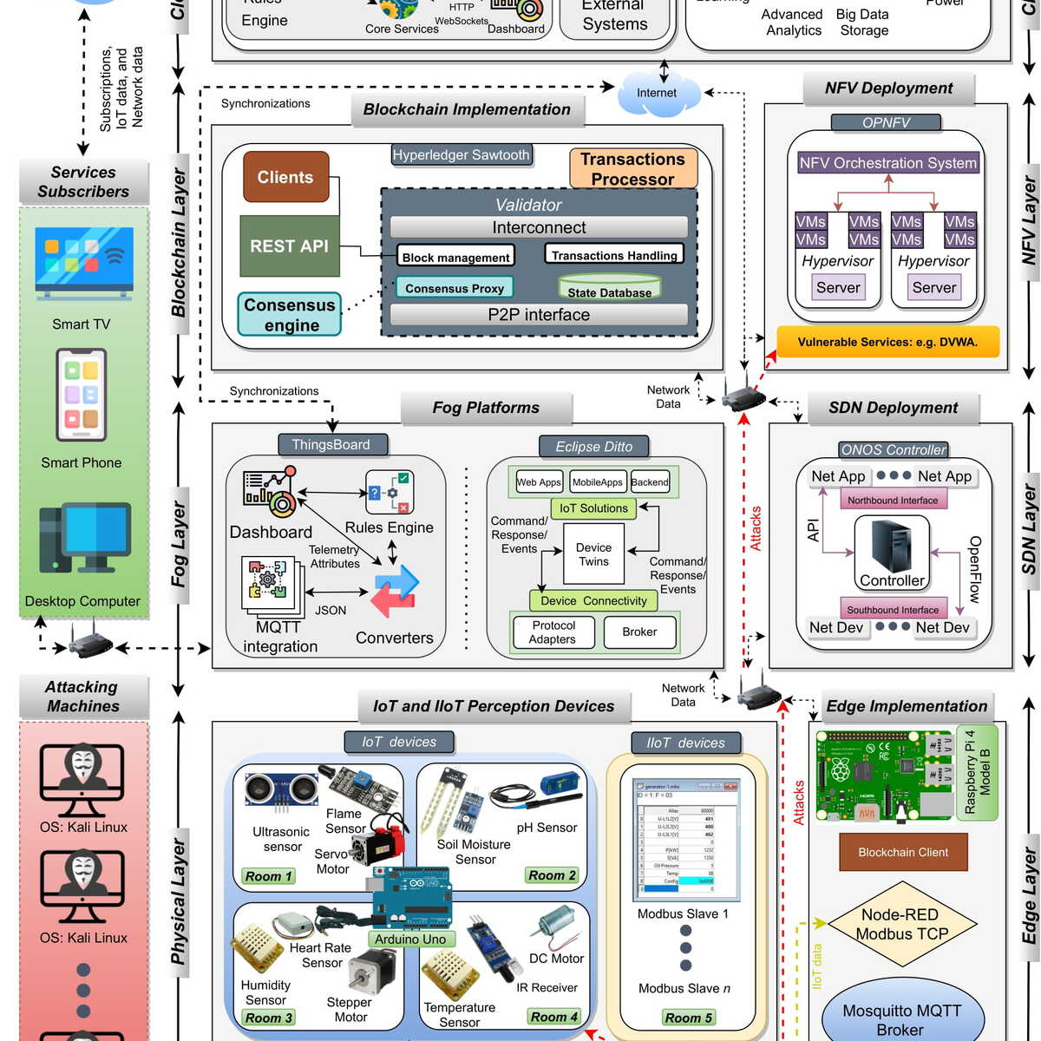
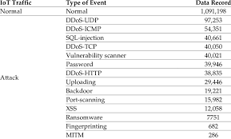
Edge IoT dataset

Slide 24
CNN-Transformer Model for Network Anomaly Detection
21

Slide 25
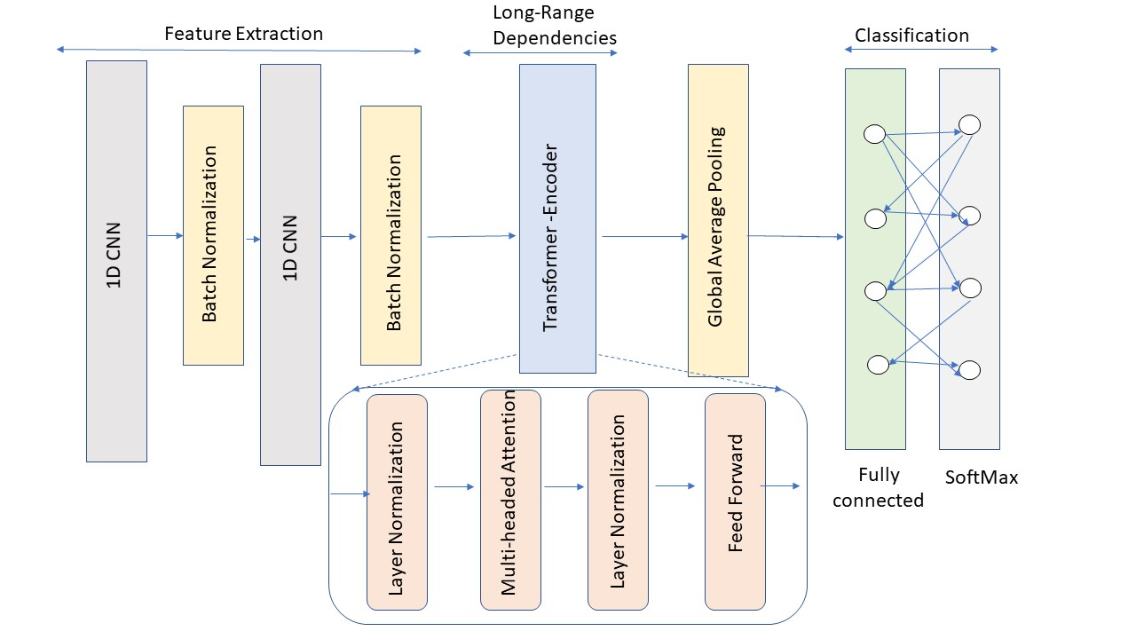
CNN-Transformer Model Structure
https://www.tntech.edu/ceroc | @TechCEROC | ceroc@tntech.edu
25
Notes:
The convolutional layers detect patterns and features in the network data, which are combined to gain a more comprehensive understanding of network behavior.
Transformers, initially designed for NLP, excel at capturing long-range dependencies and relationships in sequential data through their self-attention mechanism.
This is especially valuable in network anomaly detection, where correlations across distant time steps or features can be crucial.

Slide 26
Adversarial Attacks on ML Based Network Anomaly Detection
21

Slide 27
Attacks on the Machine Learning pipeline
Learned Parameters
Learning algorithm
Training data Attack
X
Training data Training set poisoning
_{y}
Test input Adversarial Examples
Test output Model theft

Slide 28

Definition
“Adversarial examples are inputs to machine learning models that an attacker has intentionally designed to cause the model to make a mistake”
(Goodfellow et al 2017)

Slide 29


I.I.D. Machine Learning
Train
Test
I: Independent I: Identically D: Distributed
All train and test examples drawn independently from same distribution

Slide 30

Security Requires Moving Beyond I.I.D.
Not identical: attackers can use unusual inputs
(Eykholt et al, 2017)
Not independent: attacker can repeatedly send a single mistake (“test set attack”)

Slide 31
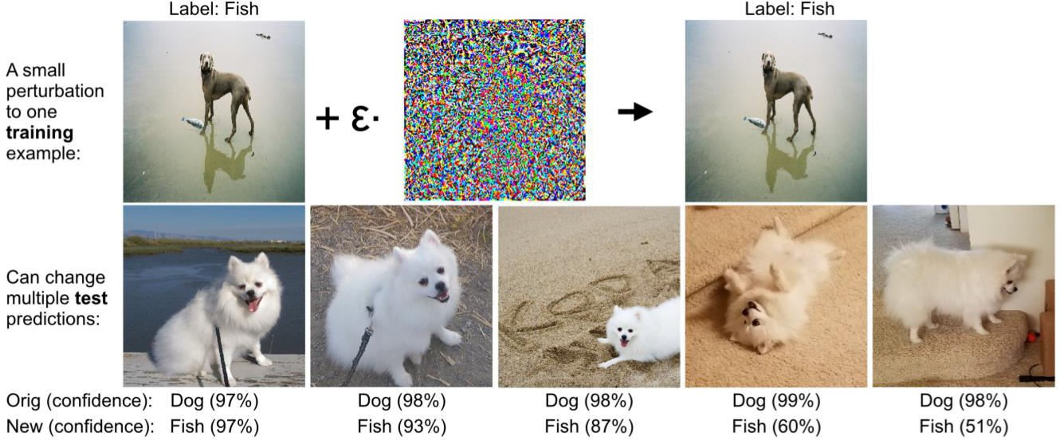
Training time
7
Setting: attacker perturbs training set to fool a model on a test set
Training data from users is fundamentally a huge security hole
More subtle and potentially more pernicious than test time attacks, due to coordination of multiple points

Slide 32




Poisoning Attacks

Slide 33


Formalization
Alice picks a data set 𝑆 of size 𝑚
Alice gives the data set to Bob
Bob picks
𝜖 𝑚 points 𝑆^{𝐵}
Gives the data set 𝑆∪ 𝑆^{𝐵} back to Alice
Or could replace some points in 𝑆
Goal of Bob
Maximize the error for Alice
Goal of Alice
Get close to learning from clean data

Slide 34
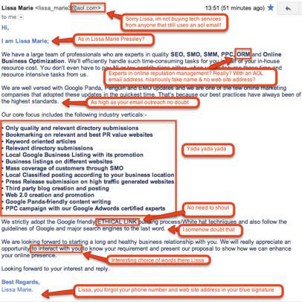
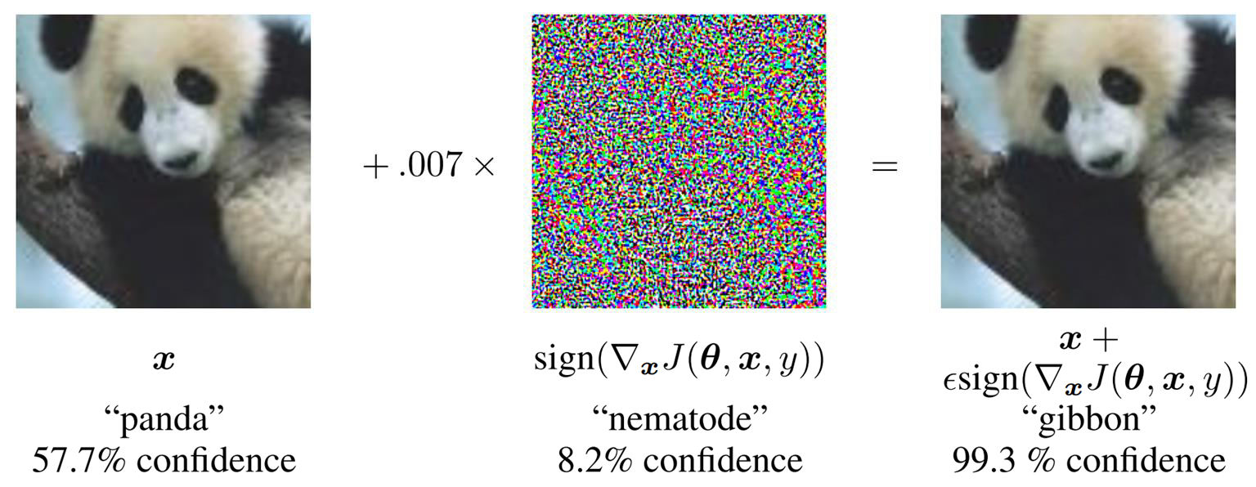
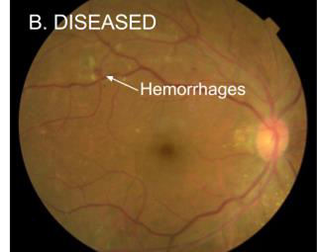
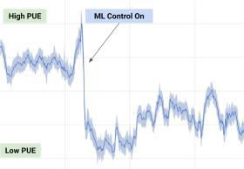
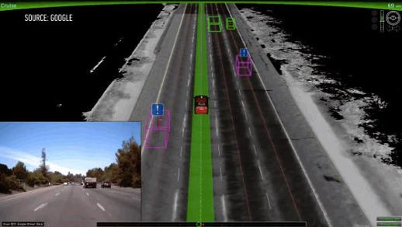

What if the adversary systematically found these inputs?
Biggio et al., Szegedy et al., Goodfellow et al., Papernot et al.
31

Slide 35



Good models make surprising mistakes in non-IID setting
“Adversarial examples”
+
=
Schoolbus
Perturbation
(rescaled for visualization)
(Szegedy et al, 2013)
Ostrich

Slide 36
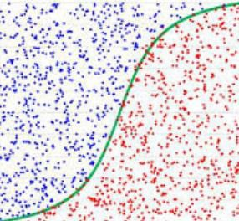
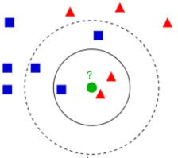

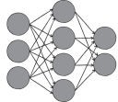

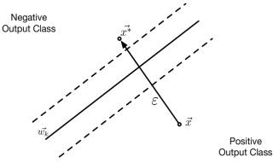
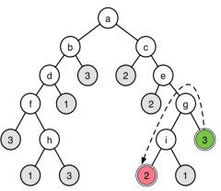
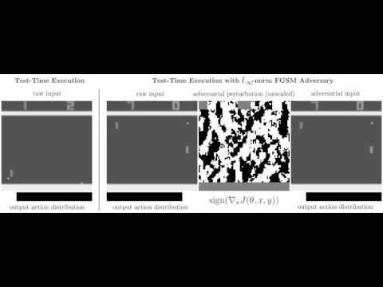
Adversarial examples...
… beyond deep learning
… beyond computer vision
P[X=Malicious] = 0.90
P[X=Benign] = 0.10
P[X*=Malicious] = 0.10
P[X*=Benign] = 0.90
Logistic Regression
Nearest Neighbors
Support Vector Machines
Decision Trees
33

Slide 37
Threat Model
White Box
Complete access to the classifier 𝐹
Black Box
Oracle access to the classifier 𝐹
for a data 𝑥 receive 𝐹(𝑥)
Grey Box
Black-Box + “some other information”
Example: structure of the defense

Slide 38
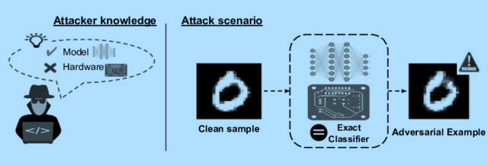
White Box

Slide 39
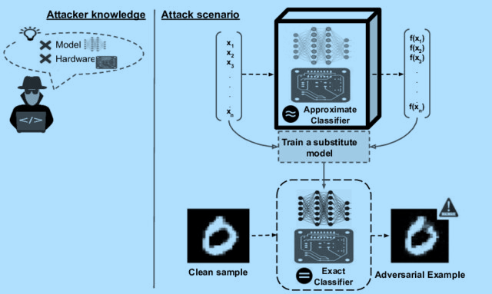
Black Box

Slide 40
FGSM (misclassification)
Take a step in the
direction of the gradient of the loss function
𝛿 = 𝜖 𝑠𝑖𝑔𝑛(Δ_{𝑥} 𝑙 𝑤, 𝑥, 𝐹 𝑥 )
Essentially opposite of what SGD step is doing
Paper
Goodfellow, Shlens, Szegedy. Explaining and harnessing adversarial examples. ICLR 2018

Slide 41
PGD Attack (misclassification)
𝐵 𝑥, 𝜖 _{𝑞}
𝑞 = ∞, 1 , 2, … .
A ϵ ball around 𝑥
Initial
𝑥₀ = 𝑥
Iterate 𝑘 ≥ 1
𝑥_{𝑘} = 𝑃𝑟𝑜𝑗 𝐵 𝑥, 𝜖 _{𝑞}
^{[ 𝑥} 𝑘−1
+ 𝜖 𝑠𝑖𝑔𝑛 Δ_{𝑥} 𝑙 𝑤, 𝑥, 𝐹 𝑥 ]

Slide 42
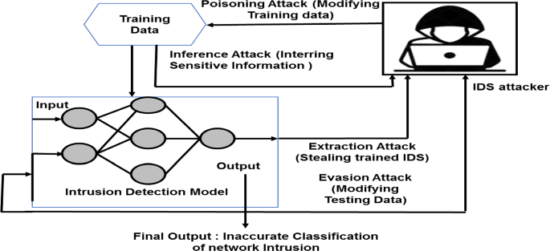
Adversarial attacks on Network ADs

Slide 43
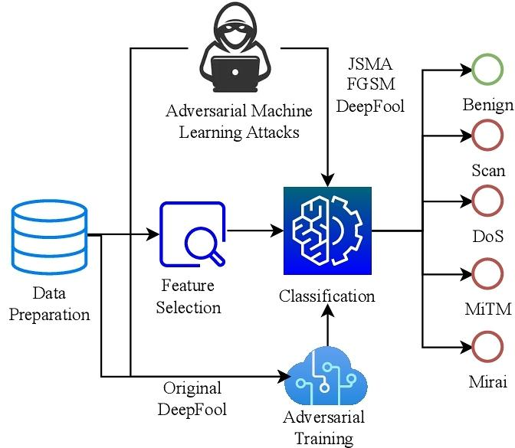
Adversarial attacks on Network ADs

